Slide 1




Versioning with git
BTM 2017 – Tom Boissonnet

Slide 2
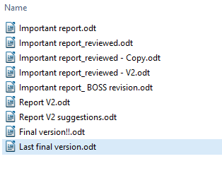
Bad versioning

Slide 3
What's the problem there ?
Every piece of the file is duplicated, even the unedited parts
Modifications are dispersed across the versions
Need to think about new names every time
Not synchronised across computers

Slide 4
What could we do
Instead of duplicating all files, keeping the only original file
Having beside a journal to keep track of all modifications
Share just these two files instead of a whole librairy

Slide 5


Ever heard about Version control software ?
Git the most popular today, with the plateform GitHub

Slide 6
Git origin
Linus Torvald, creator of Linux, key figure of OpenSource
Git created in 2005 to initially develop the linux kernel
WWCVSND What would CVS not do ? If in doubt, make the exact opposite decision

Slide 7
Git functionalities
Keep track of modifications: new files, additions, deletions
Work on different branches
Revert back and forth to other versions
Allow editing by multiple person: Authentification

Slide 8
GitHub functionalities
Cloud storage for files and the git tracking
Graphic interface
Code release, wiki, statistics, issues, projects

Slide 9


git init
Computer
git_btm2017

Slide 10
*
master
Commit 0
Commit 1

Slide 11
git commit -m ‘Modif message 2’
*
master
Commit 0
Commit 1
Commit 2

Slide 12
git branch newFeature
*
master
Commit 0
Commit 1
Commit 2
newFeature

Slide 13
git checkout newFeature
master
Commit 0
Commit 1
Commit 2
*
newFeature

Slide 14
git commit -m ‘Modif message 3’
master
Commit 0
Commit 1
Commit 2
Commit 3
*
newFeature

Slide 15
git commit -m ‘Modif message 4’
master
Commit 0
Commit 1
Commit 2
Commit 3
Commit 4
*
newFeature

Slide 16
git checkout master
*
master
Commit 0
Commit 1
Commit 2
Commit 3
Commit 4
newFeature

Slide 17
git merge newFeature
*
master
Commit 0
Commit 1
Commit 2
Commit 3
Commit 4
newFeature
« Fastforward merging »

Slide 18
*
master
Commit 0
Commit 1
Commit 2
Commit 3
Commit 4
newFeature

Slide 19
git commit -m ‘Modif message 5’
*
master
Commit 0
Commit 1
Commit 2
Commit 5
Commit 3
Commit 4
newFeature

Slide 20
git merge newFeature
*
master
Commit 0
Commit 1
Commit 2
Commit 5
Commit 6
Commit 3
Commit 4
« Recursive merging »
newFeature

Slide 21
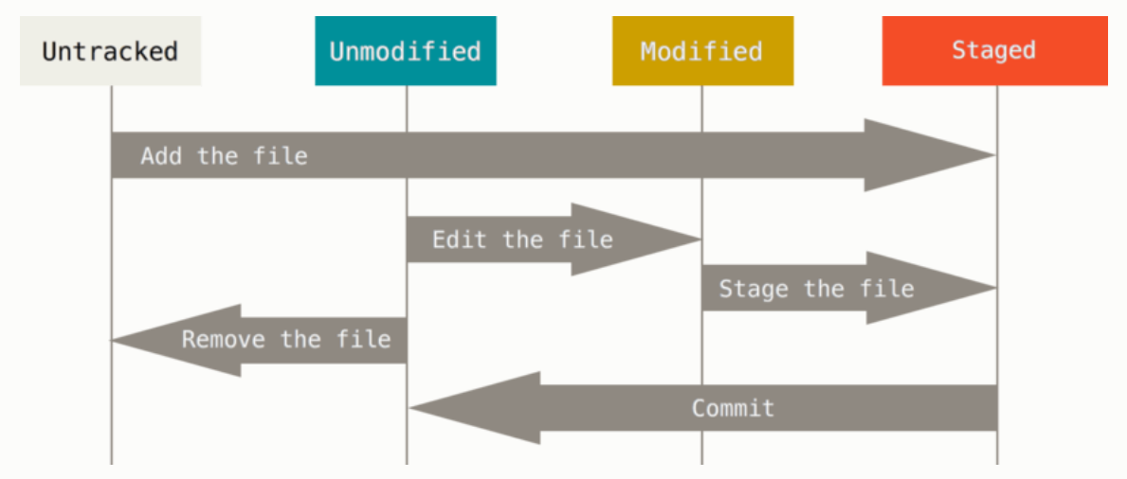
No git
git
git add
git add
git rm
git commit
The life cycle of your files Git documentation

Slide 22
GitHub
Repository
Repository
Tom-TBT/btm2017
banana52/btm2017
Fork

Slide 23
GitHub
Repository
Repository
Tom-TBT/btm2017
banana52/btm2017
git clone https://github.com/banana52/btm2017
Computer
Local copy
btm2017
remote
origin

Slide 24
GitHub
Repository
Repository
Tom-TBT/btm2017
banana52/btm2017
git fetch
Computer
git push
Local copy
btm2017
remote
origin

Slide 25
git fetch origin
*
master
Commit 0
Commit 1
Commit 2
Commit 3
Commit 4
origin/master

Slide 26
git merge origin/master
*
master
Commit 0
Commit 1
Commit 2
Commit 3
Commit 4
origin/master

Slide 27
Looking at git info :
git status
git log
git log --pretty=oneline –graph
git diff <file>
git remote show
Staging and commiting :
git add <file> >>>>Add <file> to stage
git rm <file> >>>> Remove <file> from tracking and delete it
git mv <orig> <dest> >>>> Move <orig> to <dest> (useful for renaming)
git commit -m "Don’t forget the message" >>>> Commit the staged changes
Playing with branches :
git branch <branch> >>>> Create a branch named <branch>
git checkout <branch> >>>> Change current branch to <branch>
git merge <branch> >>>> Merge <branch> onto the current branch
git fetch <remote> >>>> Ask to <remote> to import online changes (but don’t merge → merge it with git merge <remote/branch>)
git push >>>> Push local changes to online repository (you need permission)
Undos :
git commit –ammend >>>> Add staged modif to the last commit (if you forgot something)
git --reset HEAD <file> >>>> Unstage a file
For other undos, it can be dangerous. Ask google.

Slide 28
Before starting
Same file can be modified by several person at a time
What if the file is edited at the same place at the same time ?
What modification is saved ?
-> Owner of the file will need to solve conflicts

Slide 29
Let's create something collaborative !

Slide 30
Extra links:
https://try.github.io
https://git-scm.com/book/en/v2/Getting-Started-About-Version-Control
https://www.google.it/search?q=git

